Slide 1
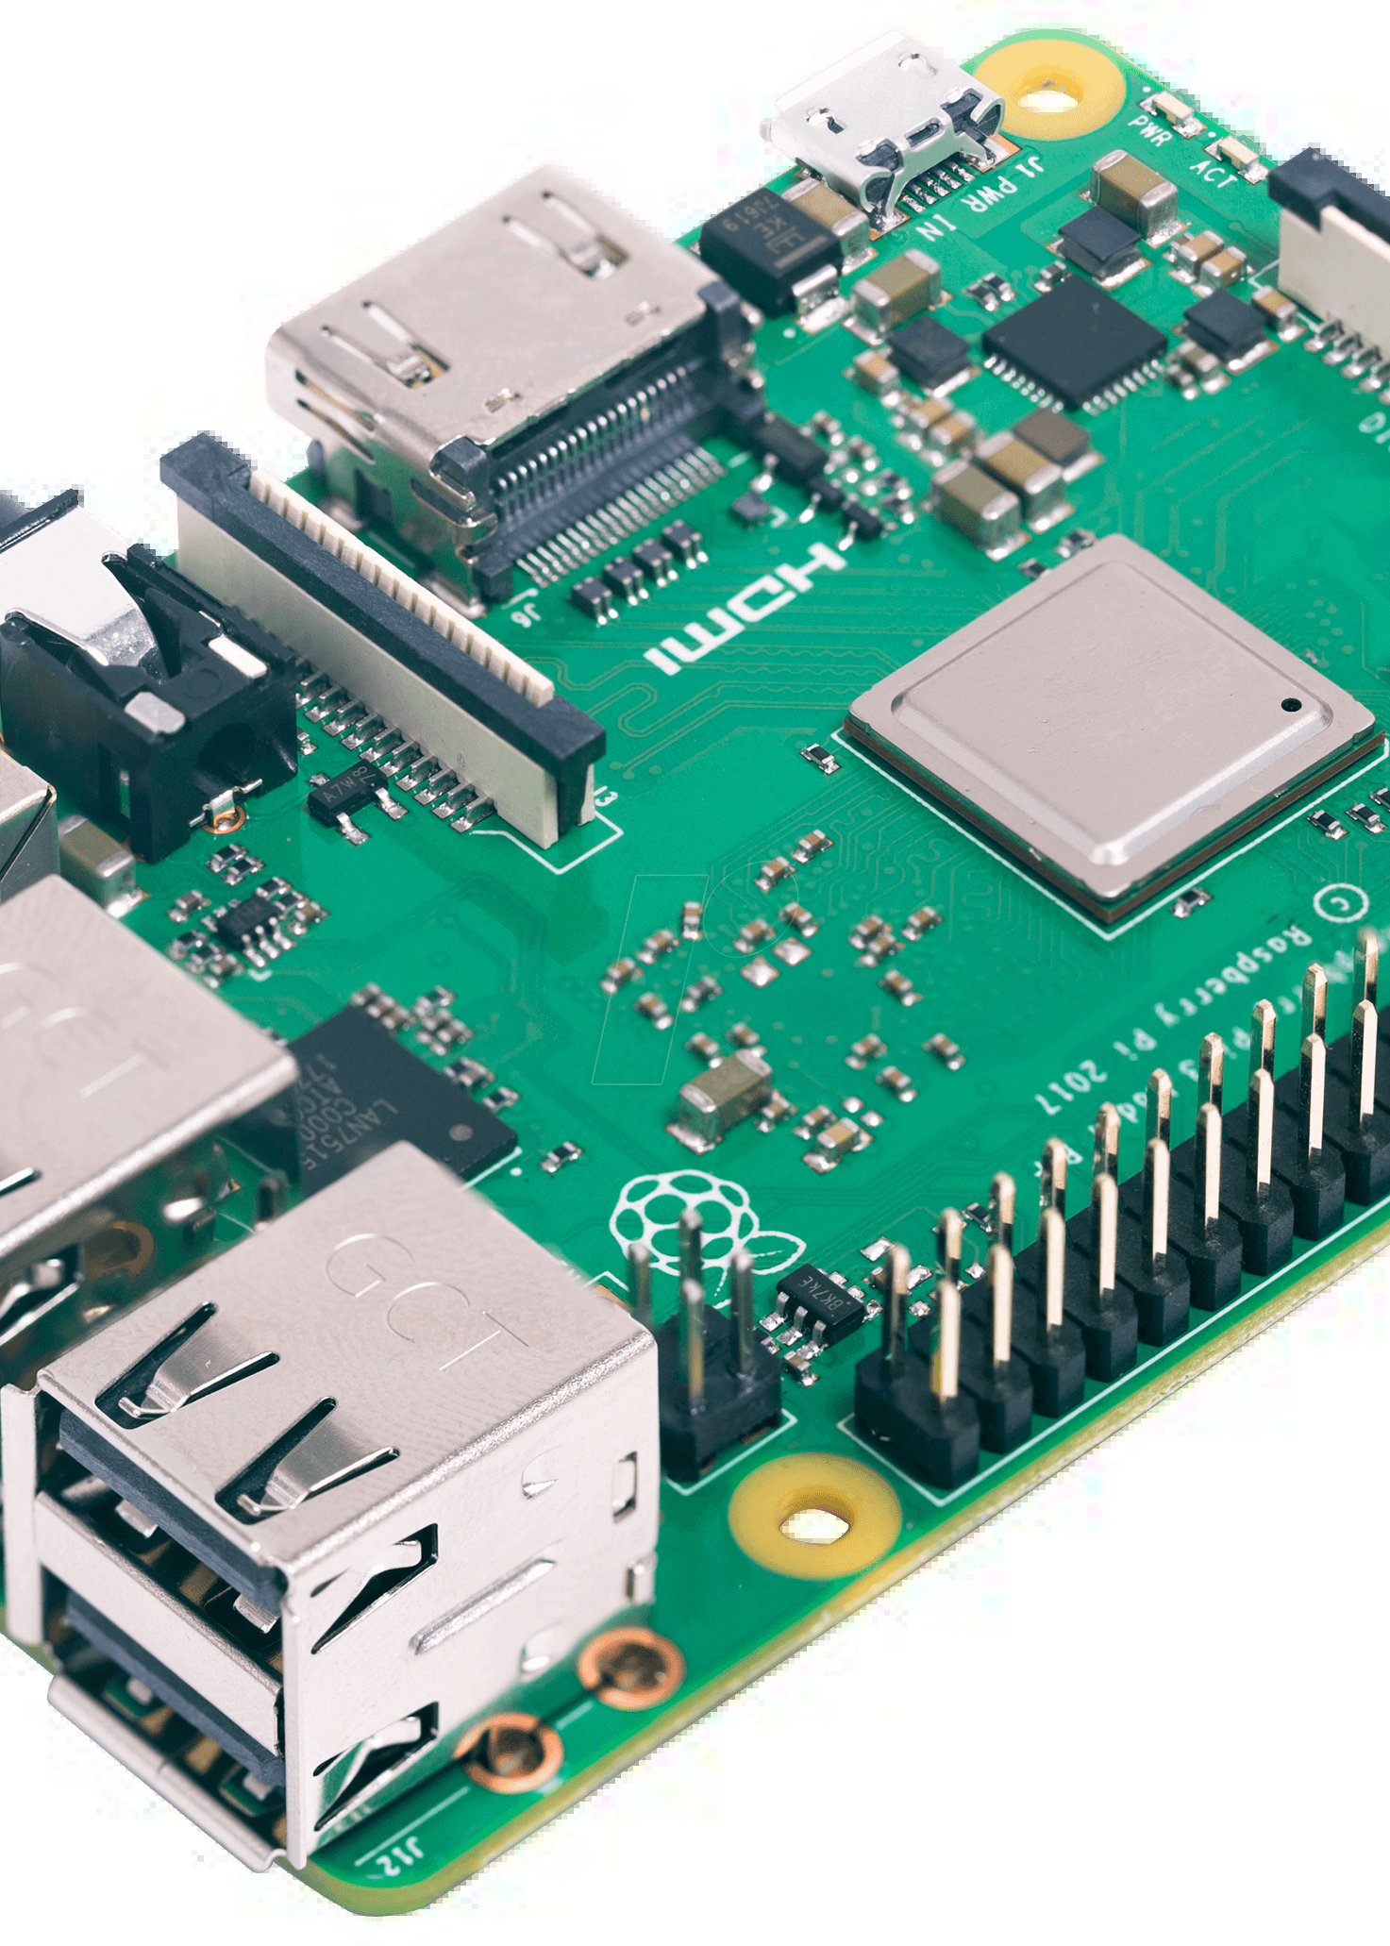
Obstacle Detection Using Raspberry Pi and Distance Sensor
Obstacle detection is an important aspect of robotics and automation. In this presentation, we will explore how we can use a Raspberry Pi and a distance sensor to create an obstacle detection system.
SUBMITTED BY –
DIVYAM BHUSHAN (10)
TATHAGAT KOUSHIK (31)
PRIYANSHU KUMAR (34)
NARENDRA KUMAR(35)
HARSH LAD(37)
JAY KUMAR PRAJAPATI(55)

Slide 2
What is Raspberry Pi?
Raspberry Pi is a series of single-board computers developed in the UK by the Raspberry Pi Foundation. These microcomputers are capable of running various operating systems and are equipped with GPIO pins, which allow them to interact with external devices such as sensors.
Low Cost Easy to Use Powerful
Raspberry Pi is an affordable computing platform capable of running various operating systems and applications.
The Raspberry Pi is designed with beginners in mind. It's easy to set up and start using.
Despite its small size, Raspberry Pi is a powerful computing device that can handle tasks such as programming, gaming, and multimedia.

Slide 3
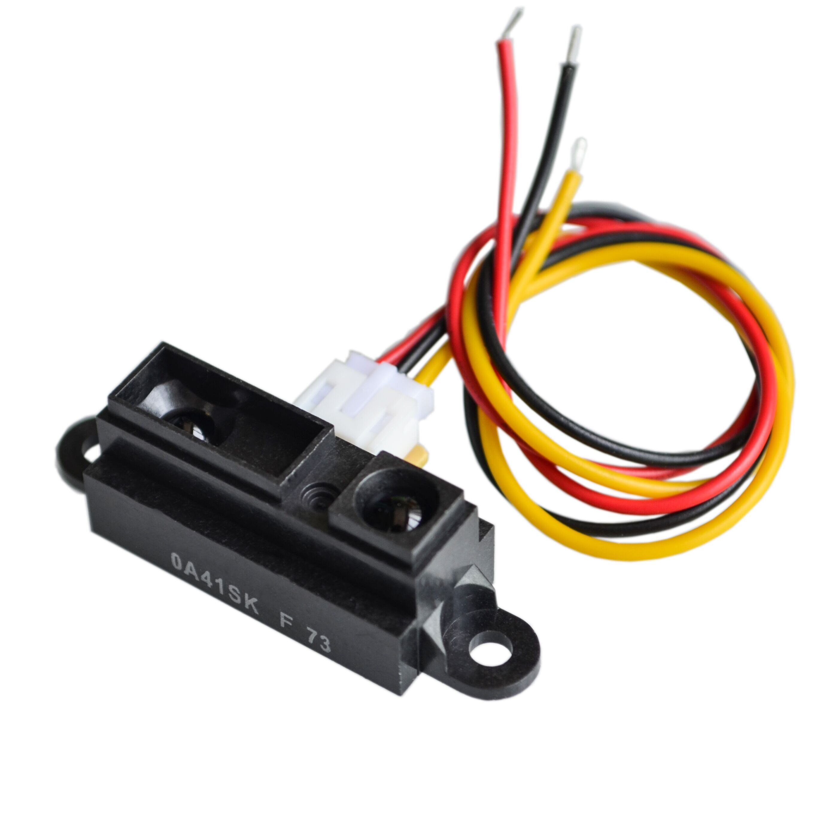
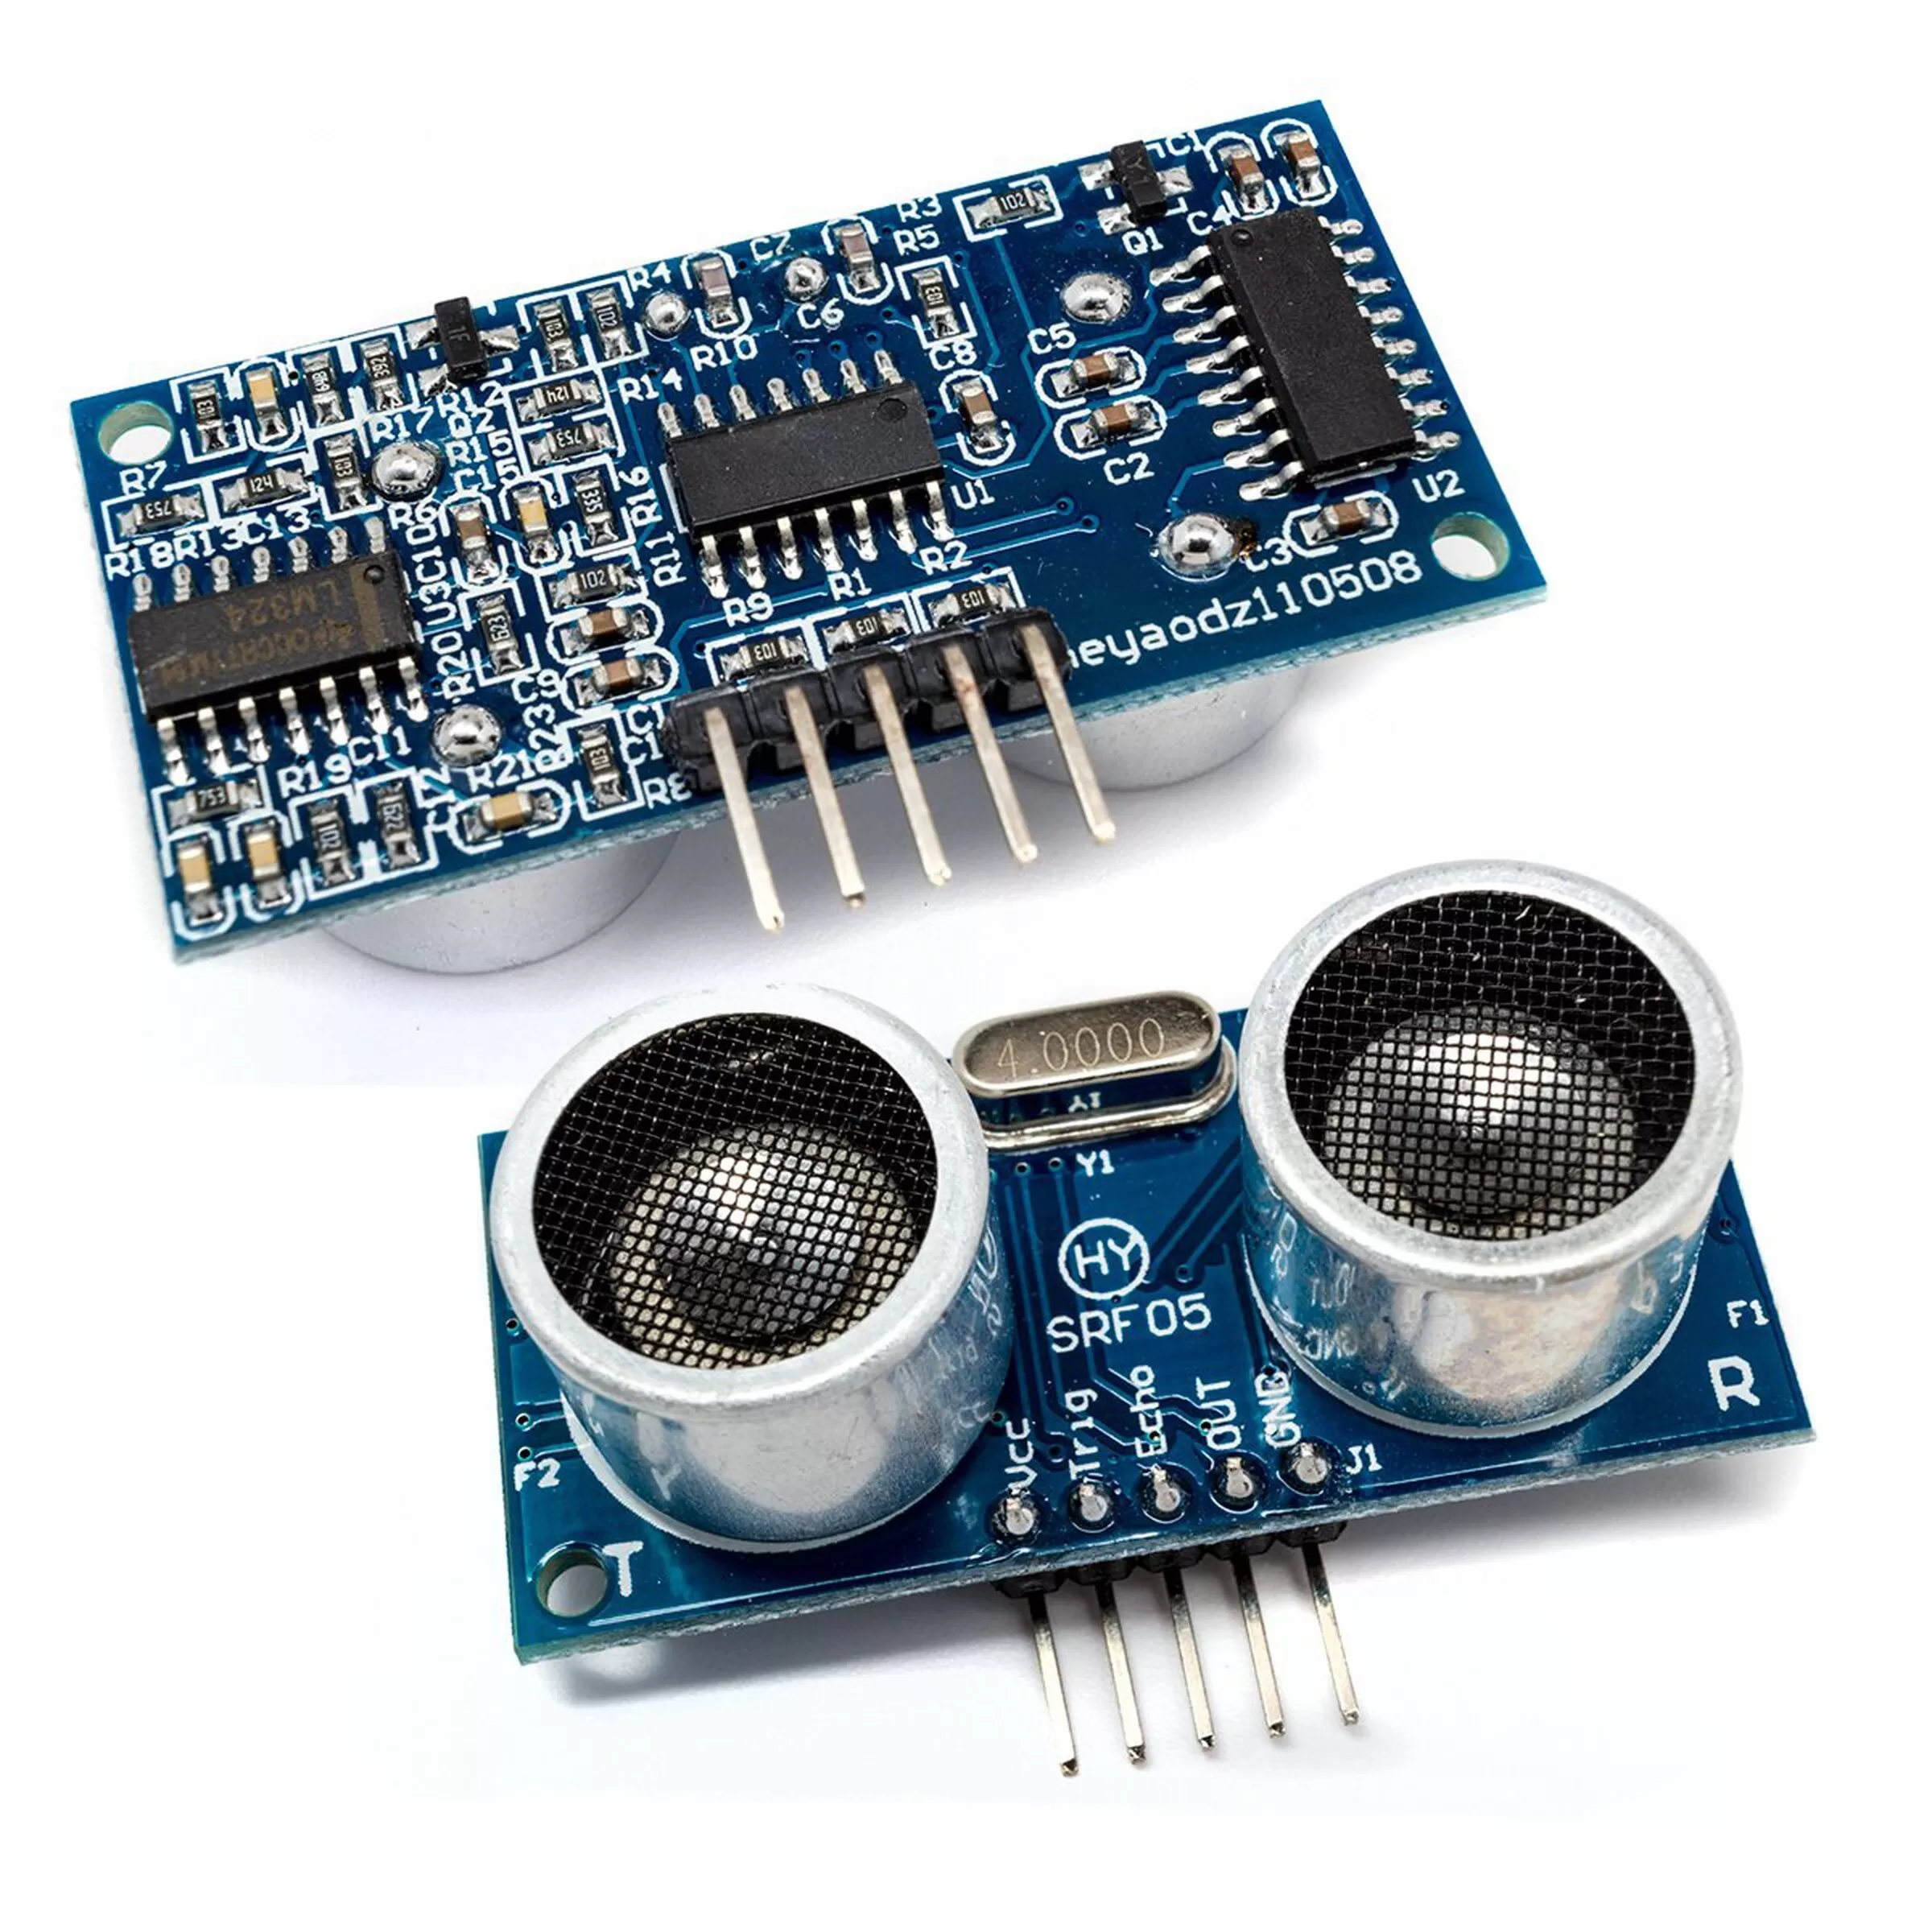
What is a Distance Sensor?
A distance sensor is a device that is used to determine the distance between the sensor and an object. It emits a signal, such as ultrasound or infrared, and measures the time it takes for the signal to bounce back to the sensor.
Infrared Sensors
Ultrasonic Sensors
Infrared sensors emit infrared light and measure the amount of reflected light to determine the distance to an object.
Ultrasonic sensors emit high- frequency sound waves and measure the time it takes for the waves to bounce back to the sensor to determine the distance to an object.

Slide 4
Setting up Raspberry Pi and Distance Sensor
To set up a Raspberry Pi and a distance sensor, we need to connect the sensor to the GPIO pins of the Raspberry Pi and install the necessary software. There are various distance sensors available in the market, such as infrared, ultrasonic, and laser sensors. Once connected, we can write a program to interface with the sensor and detect obstacles in the vicinity.
Required Components Installation Steps
Raspberry Pi, Distance Sensor, Jumper Wires, Breadboard
Connect the VCC and Ground pins of the distance sensor to the respective pins of the Raspberry Pi. Connect the Trig and Echo pins of the sensor to GPIO pins of the Raspberry Pi.
Install the necessary libraries and write the code to interface with the sensor.

Slide 5
Working Principle of Obstacle Detection
Obstacle detection is based on the principle of time-of-flight measurement. The distance sensor emits a signal, which bounces back off the object and returns to the sensor. By measuring the time it takes for the signal to travel back and forth, we can determine the distance to the object. Based on the distance, we can then classify the object as an obstacle.
Signal Reflection Obstacle Detection
The signal bounces off the object and reflects back to the sensor.
Based on the distance, the program classifies the object as an obstacle.
1
2
3
4
Signal Emission
Signal Processing
The distance sensor emits an electromagnetic signal, which travels through the air.
The sensor measures the time it takes for the signal to travel back and forth and calculates the distance to the object.

Slide 6
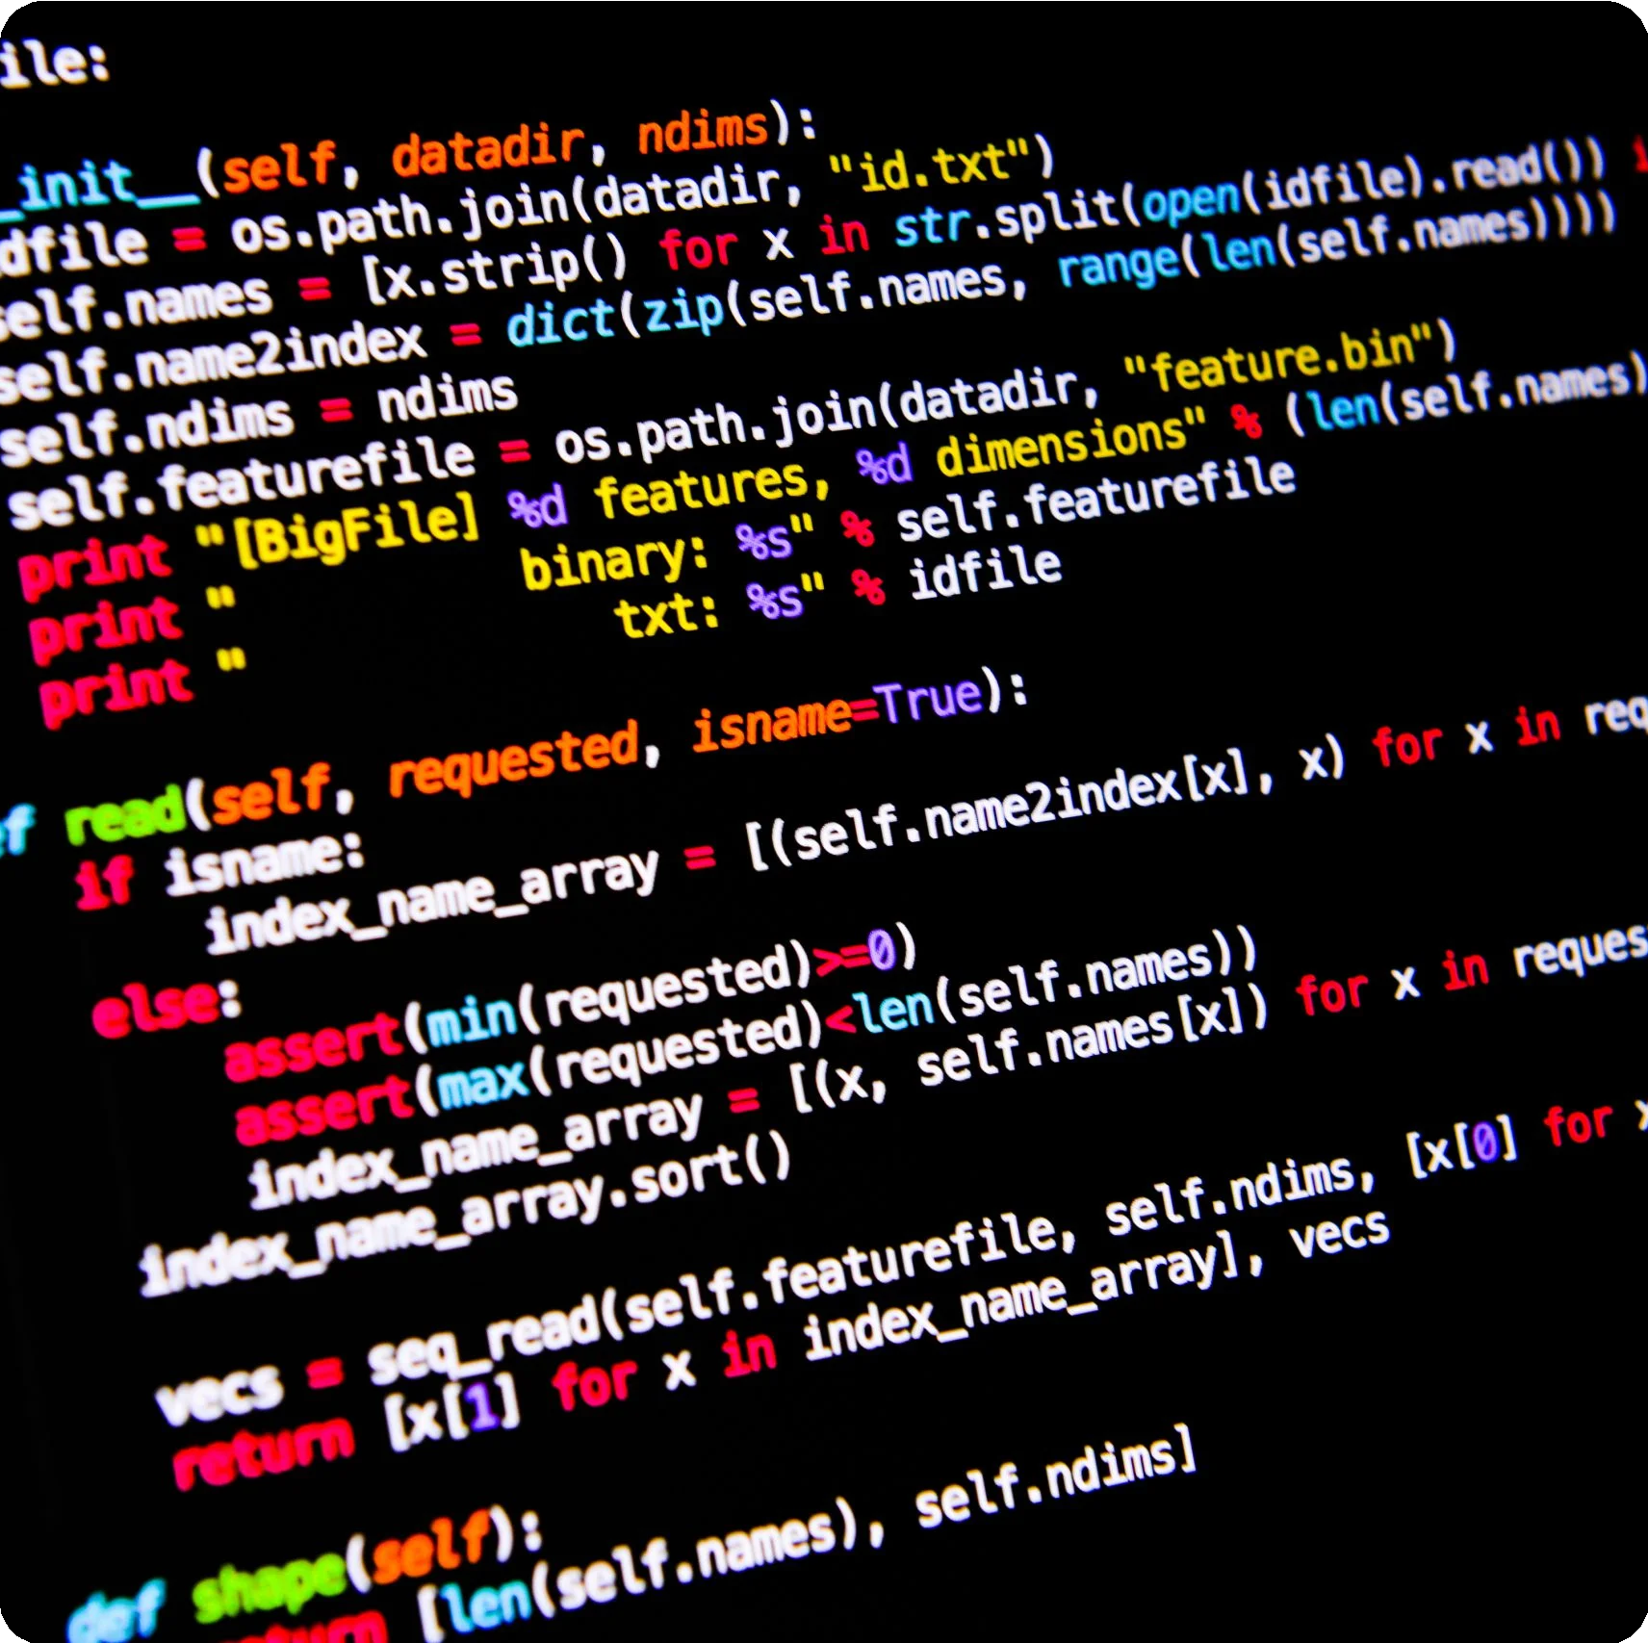
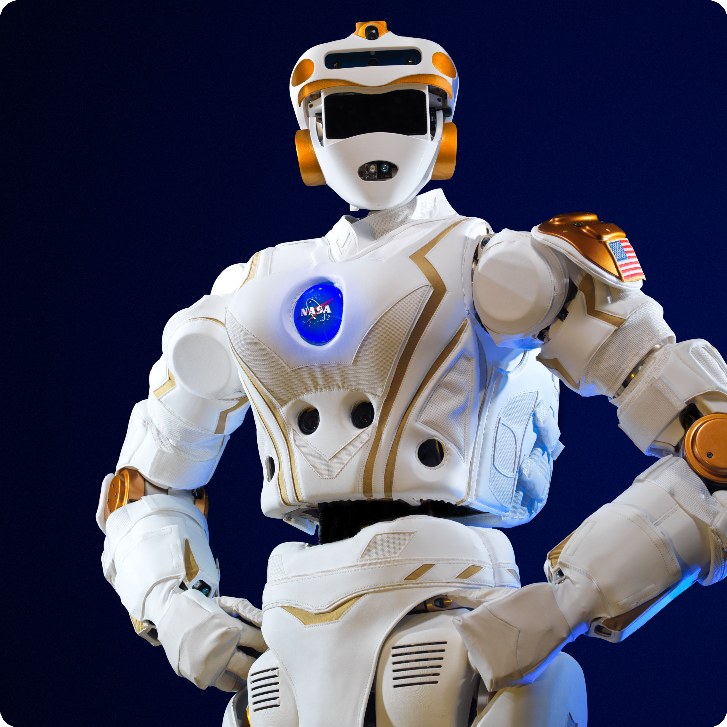
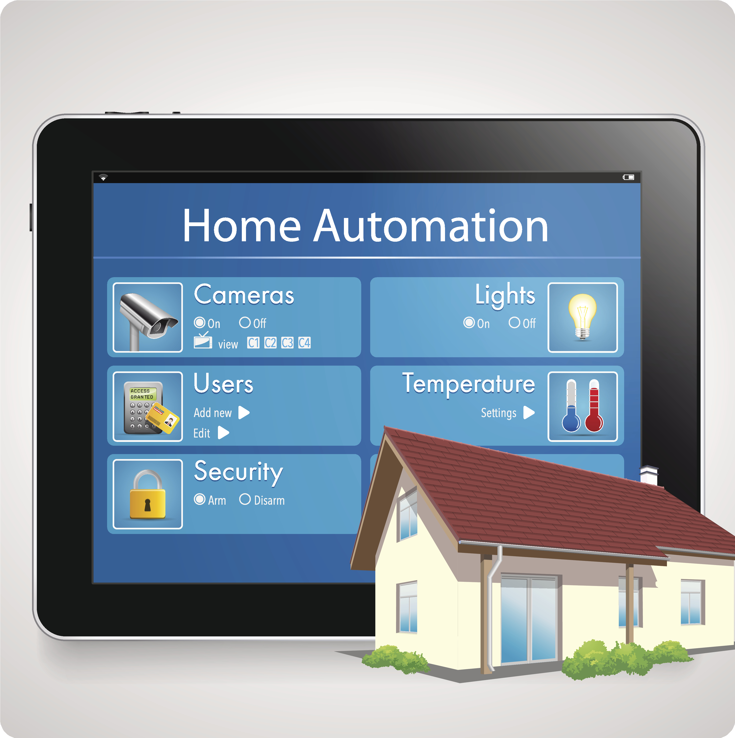
Implementation of Obstacle Detection
With Raspberry Pi and Distance Sensor, we can easily implement an obstacle detection system. We can use Python to write a program that interfaces with the sensor and detects obstacles in the vicinity of the Raspberry Pi. The program can be extended to trigger an alarm or take appropriate action based on the detected obstacles.
Python Programming
Robotics
Home Automation
We can use Python to write a program that interfaces with the sensor and detects obstacles.
Obstacle detection is an essential aspect of robotics and automation.
We can use obstacle detection to automate various tasks in our homes.

Slide 7

Conclusion
Raspberry Pi and distance sensors are versatile devices that can be used for various applications such as robotics, automation, and home automation.
With obstacle detection, we can automate tasks and make our lives easier. We hope this presentation has given you a better understanding of how to create an obstacle detection system using a Raspberry Pi and a distance sensor.
1 2
Enhanced Safety Increased Efficiency
Obstacle detection systems can help prevent accidents and enhance safety.
Automating tasks can save time and increase productivity.
3
Versatility
Raspberry Pi and distance sensors are versatile devices that can be used for various applications.

